Slide 1
Let's play a game
( should – shouldn’t)
https://wordwall.net/play/8398/082/731

Slide 2

Help your friend :

Slide 3


Lets play the directions game ☺
Please help your friend

Slide 4
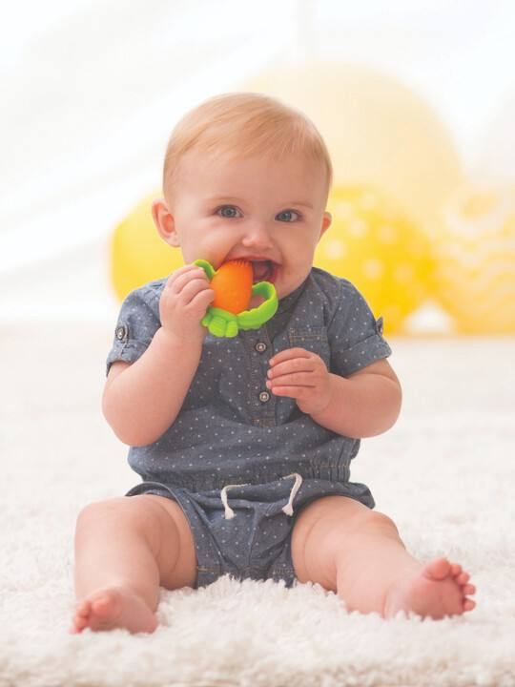

Slide 5

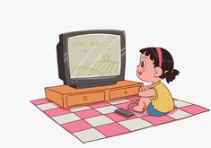

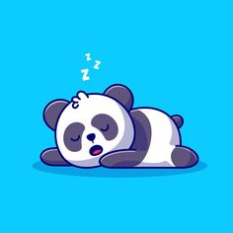
What do you do after school?

Slide 6
Do you help your parents?

Slide 7
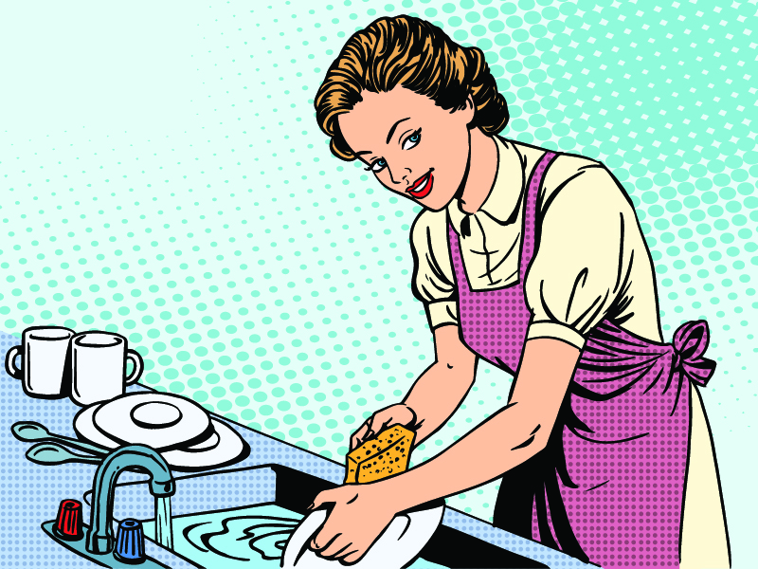
Do you do the washing up?

Slide 8
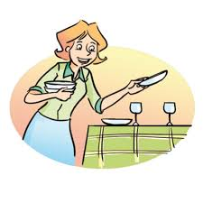
Do you lay the table?

Slide 9
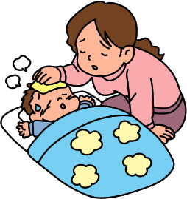
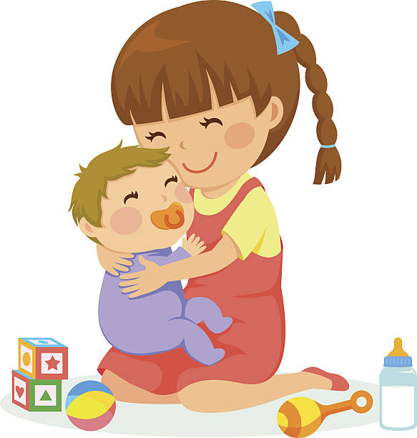
Do you look after your young brother or sister?

Slide 10
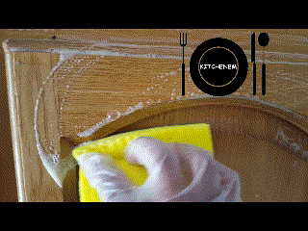
Do you clean the kitchen cabinets?

Slide 11

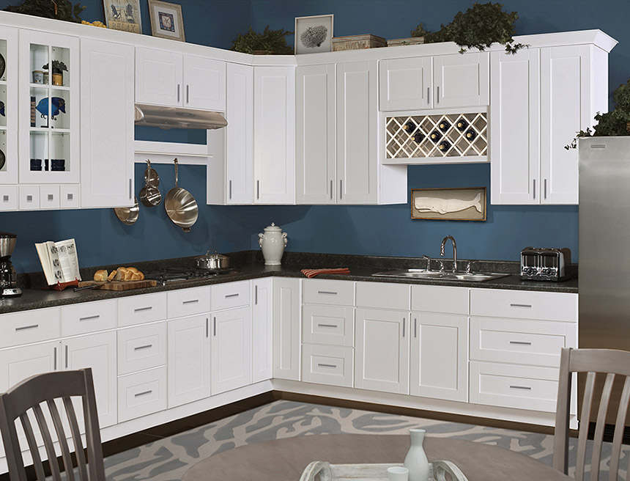
cabinet
piece of furniture with shelves, cupboards, or drawers, used for storing or showing things

Slide 12
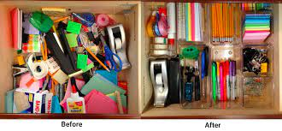
organise

Slide 13
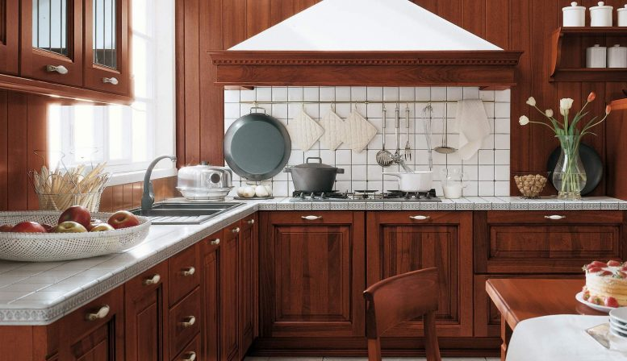
Do you help your mother to organise the kitchen cabinets?

Slide 14
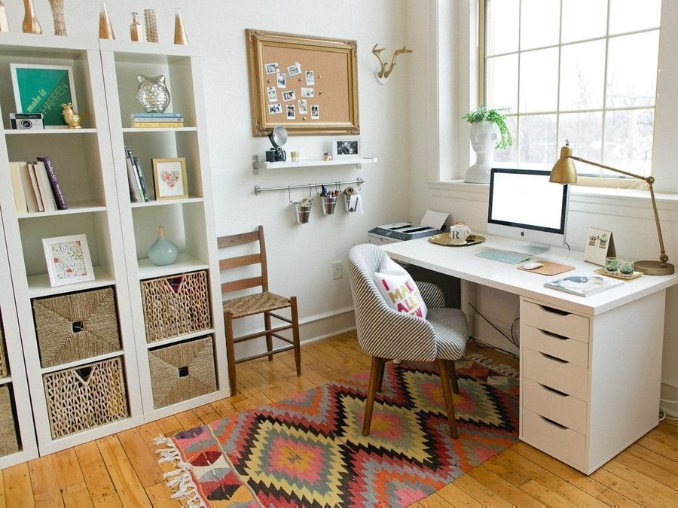
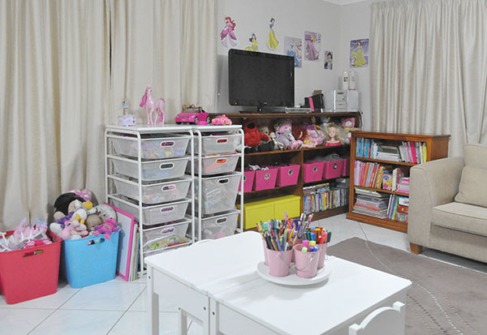
organise
to do or arrange something

Slide 15
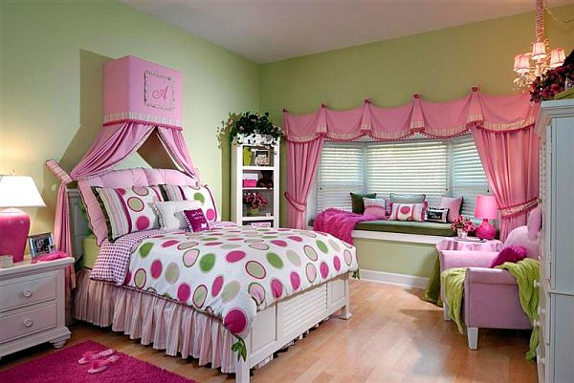
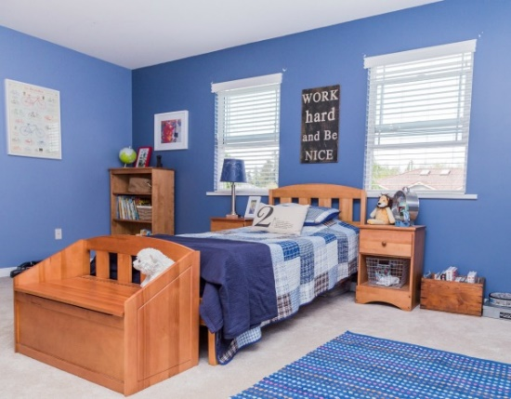
Do you regularly organise your room?

Slide 16
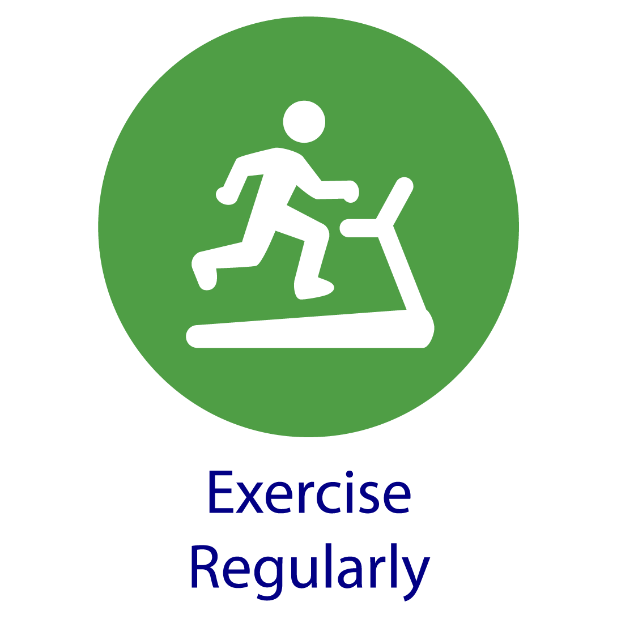

regularly

Slide 17
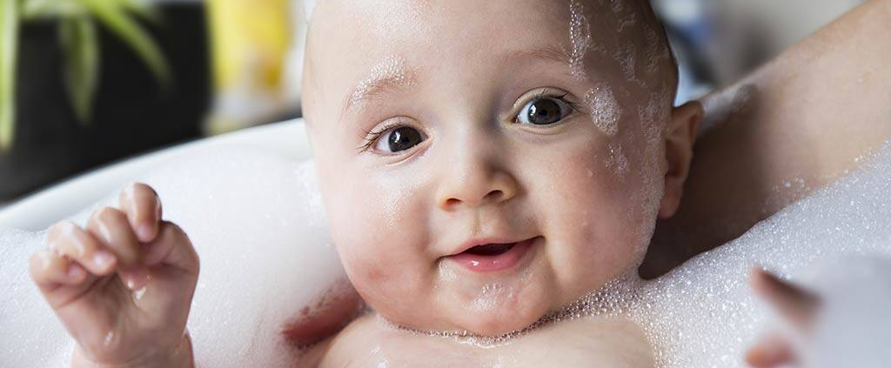
You must have a bath regularly

Slide 18
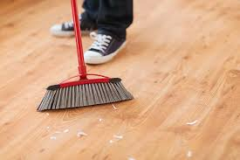
Do you sweep your room?

Slide 19
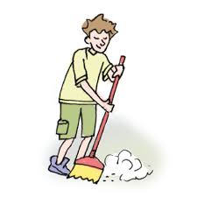

sweep
to clean especially a floor by using a brush to collect the dirt into one place from which it can be removed

Slide 20
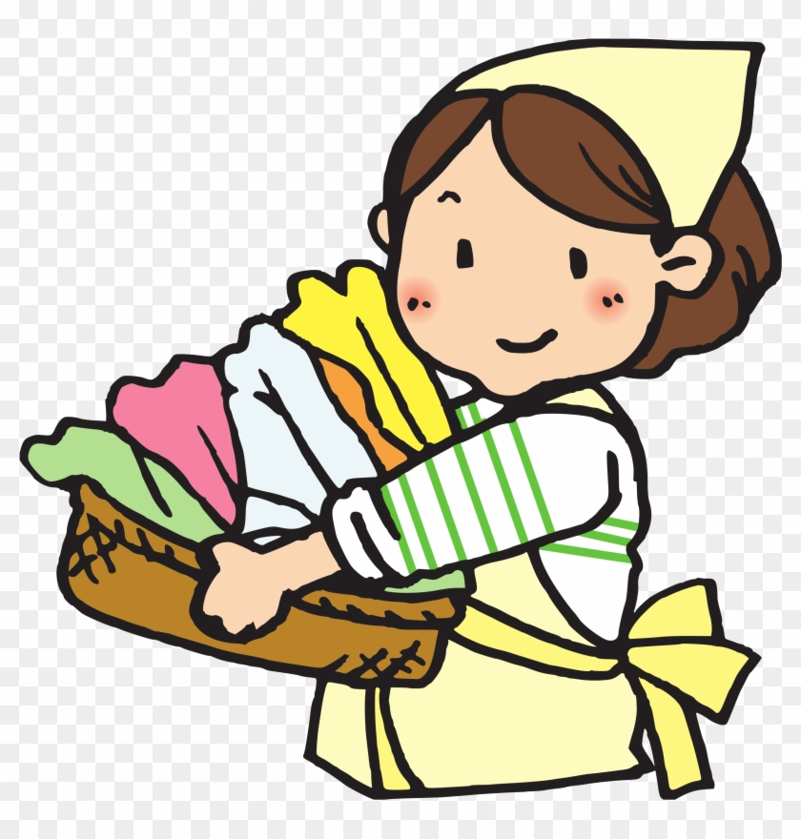
Do you regularly do the laundry?

Slide 21
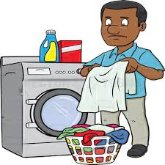
laundry
the dirty clothes and sheets that need to be, are being, or have been washed

Slide 22
New Vocabulary

Slide 23
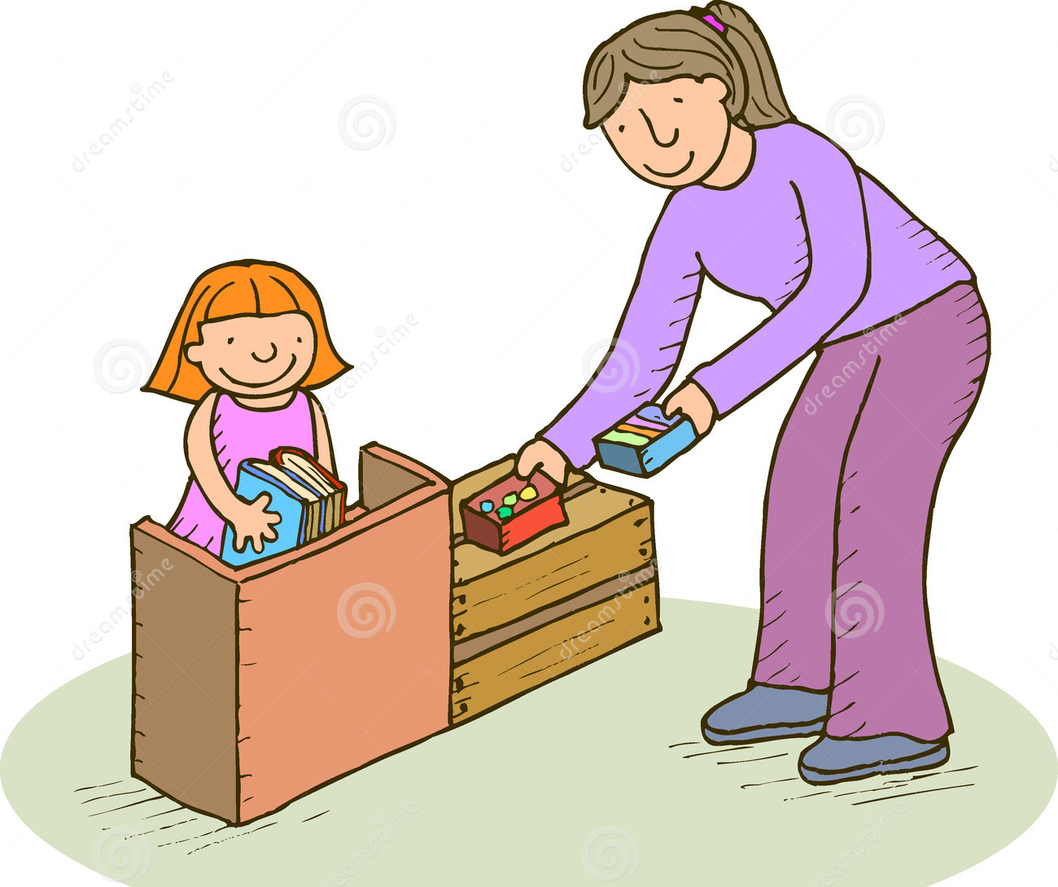
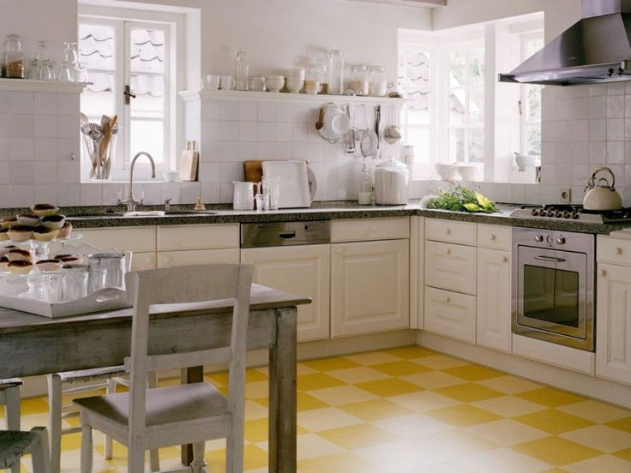

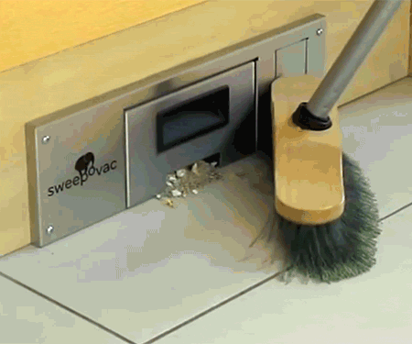
organise (v.)
cabinet (n.)
regularly (Adv.)
sweep (V.)
laundry (N.)

Slide 24
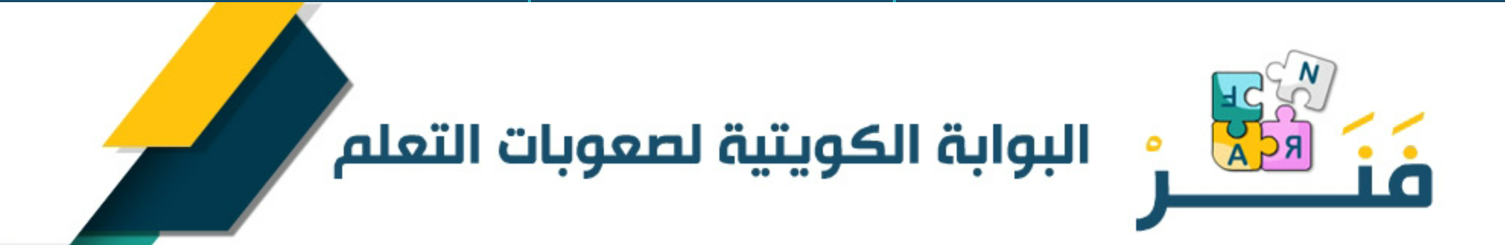

Slide 25


Slide 26


Student’s Book
Page 59

Slide 27

Where do you think the students are from ?

Slide 28


Slide 29




Slide 30
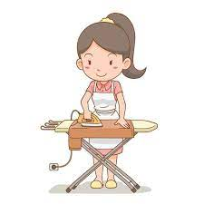
What did Fauzia have to do yesterday ?

Slide 31
What did Fauzia have to do yesterday ?
a- she had to do the washing up.
b- she had to do the ironing.
c- she had to sweep the floor.

Slide 32
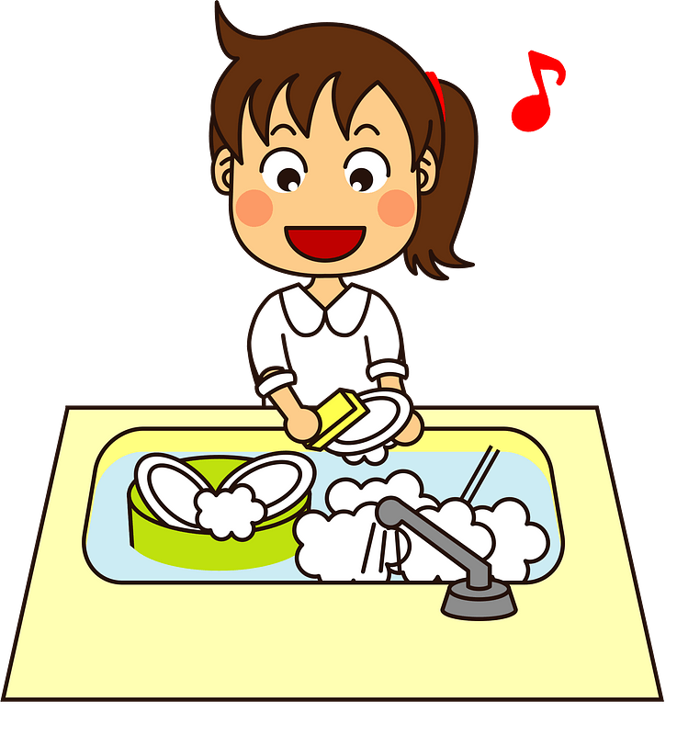
1- What did Fauzia have to do yesterday?
She had to do the washing up.

Slide 33
The opposite of the underlined word (hard) is
a- tall b- easy c- fast d-beautiful

Slide 34



Slide 35
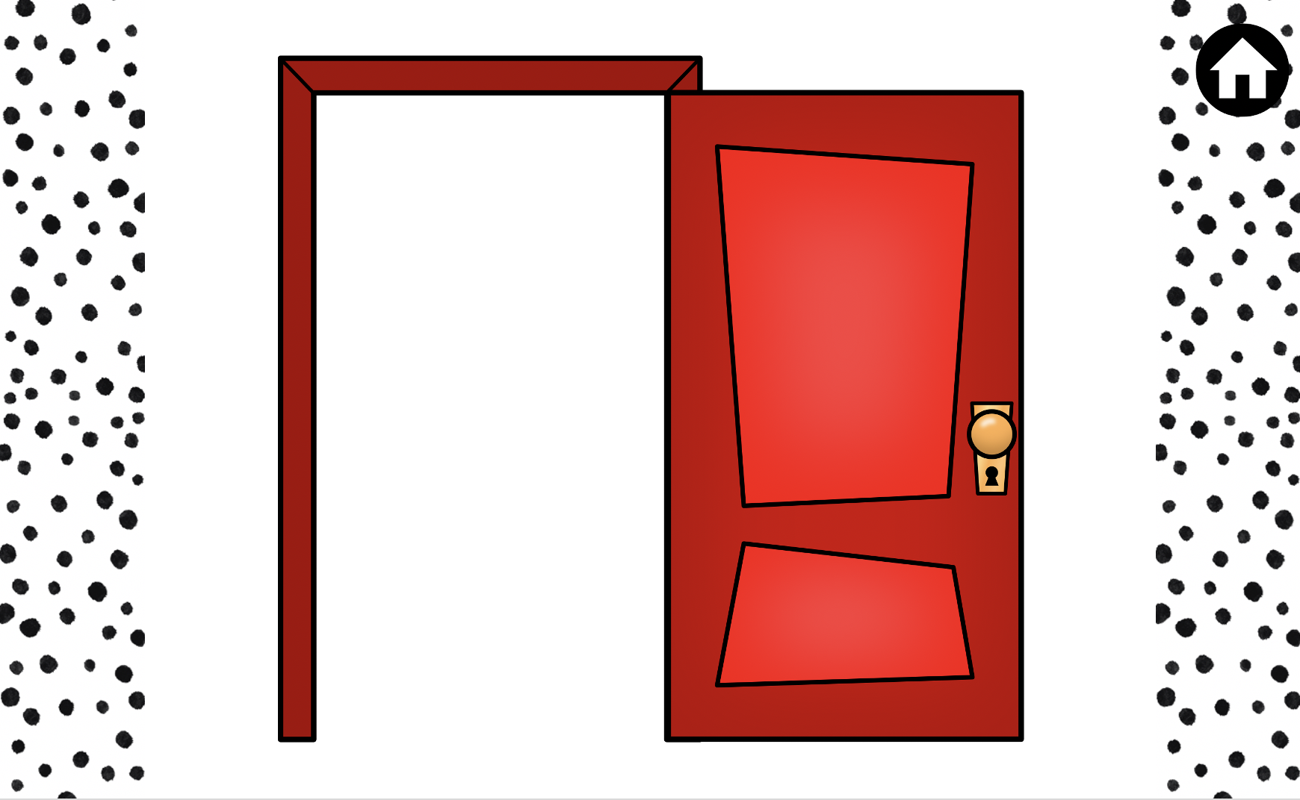
Jump three
times

Slide 36
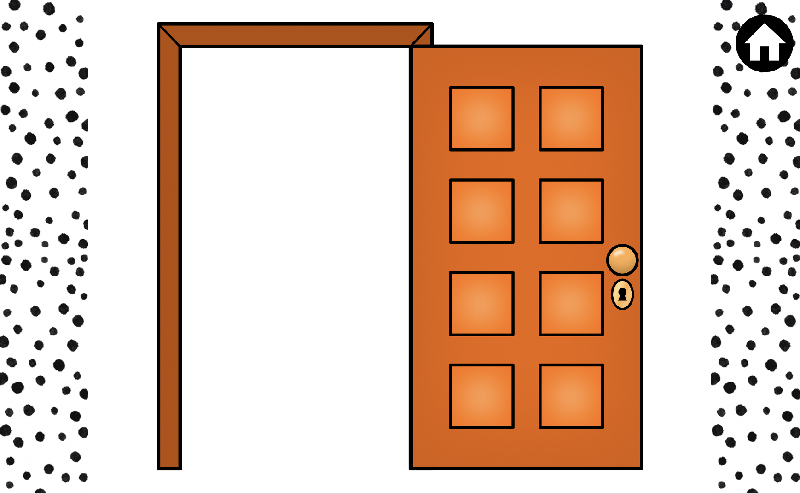

Show me
Something yellow

Slide 37


Guess which cartoon:

Slide 38

Listen carefully

Slide 39


Guess who :

Slide 40


Which country?

Slide 41
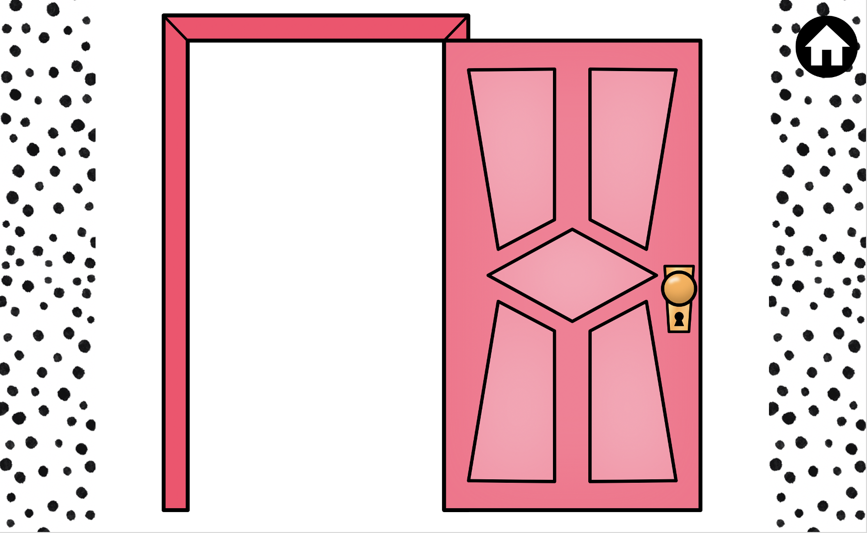

Name this cartoon

Slide 42

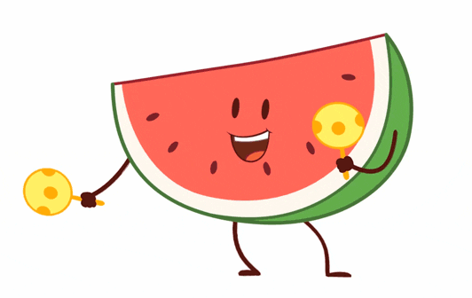

Choose something that you rarely do :
eat watermelon
watch Disney movies
eat fast food

Slide 43
3- Why didn’t Nawwaf have to help at home last week?

Slide 44
3- Why didn’t Nawwaf have to help at home last week?
a- He had a swimming training .
b- he was sick .
c- he was traveling .

Slide 45

3- Why didn’t Nawwaf have to help at home last week?
He didn’t have to help at home last week because he had a swimming training.

Slide 46

Closure

Slide 47
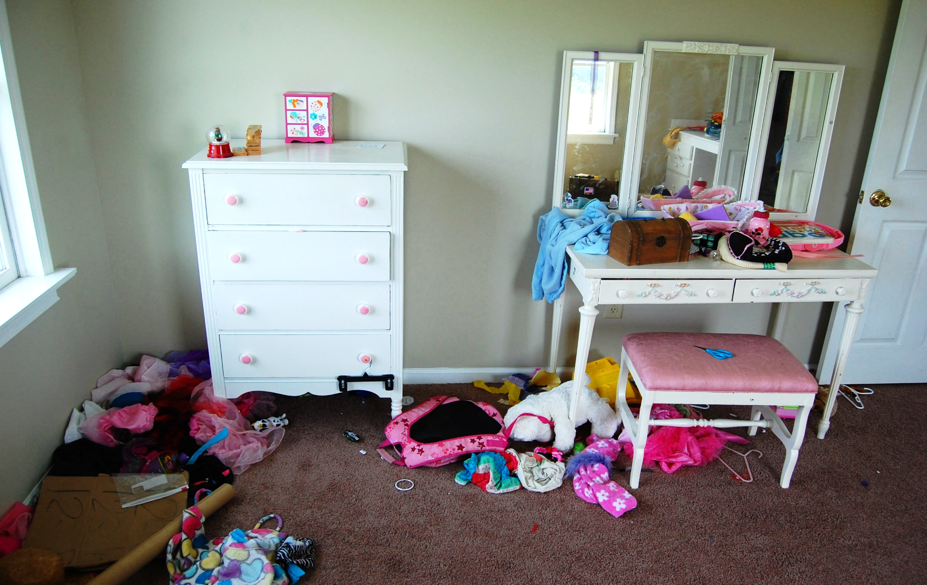

Do you organise your room?

Slide 48

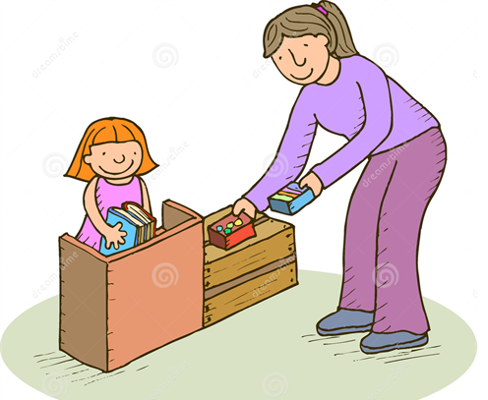

Match the word with its picture
sweep
1
2
3

Slide 49
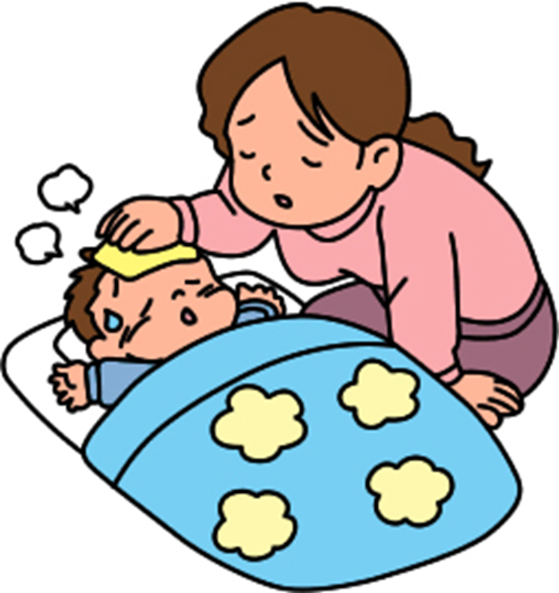
Match the word with its picture
organise
1
2
3

Slide 50
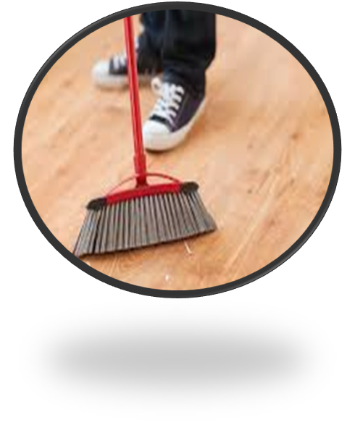
Complete the word with the missing letters
sw _ _ p

Slide 51
Complete the word with the missing letters
La_ _ dr _

Slide 52
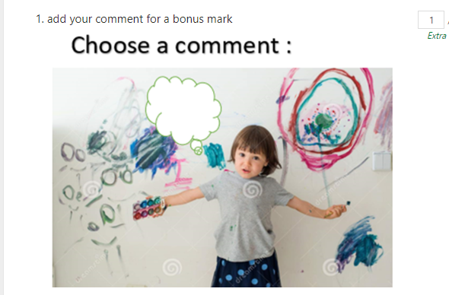

Slide 53



Best ‘comment of the day’ winner

Slide 54


Spot the differences

Slide 55
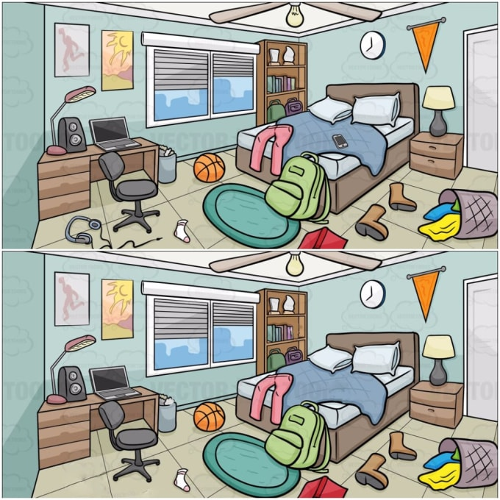
Describe the room and spot the differences

Slide 56
Goodbye
Don’t forget your homework

